Slide 1
Safety and Liveness Properties
Concurrent Programming CT074-3-2 Version 0120

Slide 2
CCP Assignment
Report
Paragraphs narrating what needs to happen and assumptions (if any)
How it was implemented (Java concurrency method/API)
Discussion (If relevant)
Potential deadlock (any conditions present)
Mutually exclusive

Slide 3
CCP Assignment
System
Implement and code salon simulation
One Submission link
2 Files in zip file
Code and Presentation (zip file) – Will not be submitted to Turnitin

Slide 4
Additional Requirements
These events should happen concurrently:
Passengers buying tickets from the 3 sources.
Each event should take some time.
As there is only 1 ticket inspector, this event should happen exclusively:
checking of passenger tickets in each waiting room

Slide 5
Customer 4 assign to hairdresser 1
Hairdresser 1 checking if comb 1 is available - true
Customer 13 is sitting on waiting chair
Customer 13 assign to hairdresser 2
Hairdresser 2 checking if comb 1 is available - false
Customer 1 is sitting on waiting chair
Customer 1 assign to hairdresser 3
Hairdresser 3 checking if comb 1 is available - false
Customer 3 is sitting on waiting chair
Customer 10 is sitting on waiting chair
Customer 8 is sitting on waiting chair
Customer 12 is sitting on waiting chair
Hairdresser 1 checking if scissor 1 is available - true
Hairdresser 1 acquired comb 1 and scissor 1…

Slide 6
Additional Requirements
These events should happen concurrently:
Passengers disembarking/embarking from the 3 gates.
Refill supplies and cleaning of aircraft
As there is only 1 refueling truck, this event should happen exclusively:
Refuelling of aircraft

Slide 7
Passenger 1 disembarking from Plane 1
Passenger 2 disembarking from Plane 1
Passenger 1 disembarking from Plane 2
Fuel truck refilling fuel for Plane 1 – 0%
…
Passenger 50 boarding Bus 1
All passengers boarded Bus 1!
Passenger 54 boarding Bus 2
Passenger 55 boarding Bus 3
Passenger 56 boarding Bus 2
Passenger 57 boarding Bus 3
…

Slide 8
Topic & Structure of The Lesson
Safety

Slide 9
Learning Outcomes
At the end of this module, you should be able to do the following:
Identify safety issues in threads

Slide 10
Key Terms You Must Be Able To Use
If you have mastered this topic, you should be able to use the following terms correctly in your assignments and exams:
Safety

Slide 11
Safety & Liveness properties
Concepts: properties: true for every possible execution
safety: nothing bad happens
liveness: something good eventually happens
Practice: threads and monitors

Slide 12
Safety: nothing bad will happen. For example, access to a shared resource like a printer requires that the user process have exclusive access to the resource.
So, there must be a mechanism to provide mutual exclusion.

Slide 13
The Dining Philosophers.
(Models exclusive access to limited resources) N philosophers spend their lives seated around a circular table thinking and eating. Each philosopher has a plate of spaghetti and, on each side, shares a fork his/her neighbor. To eat, a philosopher must first acquire the forks to its immediate left and right. After eating, a philosopher places the forks back on the table. The problem is to write a program that lets each philosopher eat and think.
The philosophers correspond to processes and the forks correspond to resources.

Slide 14
A safety property for this problem is that a fork is held by one and only one philosopher at a time. A desirable liveness property is that whenever a philosopher wants to eat, eventually the philosopher will get to eat.
Solve the dining philosophers problem using a central fork manager (centralized).
Solve the dining philosophers problem where there is a manager for each fork(distributed).
Solve the dining philosophers problem where the philosophers handle their own forks (decentralized).
Solve the dining philosophers problem if the philosophers must acquire all the forks in order to eat (distributed mutual exclusion).

Slide 15
Single Lane Bridge problem
At the moment, we are only concerned primarily with the safety properties of the problem. We will look at liveness in the next lecture.

Slide 16
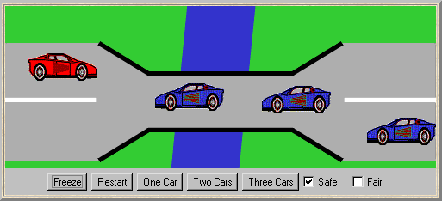
Single Lane Bridge problem
A bridge over a river is only wide enough to permit a single lane of traffic. Consequently, cars can only move concurrently if they are moving in the same direction. A safety violation occurs if two cars moving in different directions enter the bridge at the same time.

Slide 17
Single Lane Bridge - model
Events or actions of interest?
enter and exit
Identify processes.
cars and bridge
Identify properties.
oneway
Define each process
and interactions
(structure).

Slide 18
Single Lane Bridge - BRIDGE model
Cars can move concurrently on the bridge only if in the same direction. The bridge maintains counts of blue and red cars on the bridge. Red cars are only allowed to enter when the blue count is zero and vice-versa.

Slide 19
Single Lane Bridge - safety property ONEWAY
We now specify a safety property to check that cars do not collide!
While red cars are on the bridge only red cars can enter; similarly for blue cars. When the bridge is empty, either a red or a blue car may enter.

Slide 20
Single Lane Bridge - implementation in Java
Active entities (cars) are implemented as threads.
Passive entity (bridge) is implemented as a monitor.
BridgeCanvas enforces no overtaking.

Slide 21
Single Lane Bridge - BridgeCanvas
An instance of BridgeCanvas class is created by SingleLaneBridge applet - ref is passed to each newly created RedCar and BlueCar object.
class BridgeCanvas extends Canvas {
public void init(int ncars) {…} //set number of cars
//move red car with the identity i a step
//returns true for the period on bridge, from just before until just after
public boolean moveRed(int i)
throws InterruptedException{…}
//move blue car with the identity i a step
//returns true for the period on bridge, from just before until just after
public boolean moveBlue(int i)
throws InterruptedException{…}
public synchronized void freeze(){…}// freeze display
public synchronized void thaw(){…} //unfreeze display }

Slide 22
Single Lane Bridge - RedCar
class RedCar implements Runnable {
BridgeCanvas display; Bridge control; int id;
RedCar(Bridge b, BridgeCanvas d, int id) {
display = d; this.id = id; control = b;
}
public void run() {
try {
while(true) {
while (!display.moveRed(id)); // not on bridge
control.redEnter(); // request access to bridge
while (display.moveRed(id)); // move over bridge
control.redExit(); // release access to bridge
}
} catch (InterruptedException e) {}
}
}
Similarly for the BlueCar

Slide 23
Single Lane Bridge - class Bridge
class Bridge {
synchronized void redEnter()
throws InterruptedException {}
synchronized void redExit() {}
synchronized void blueEnter()
throws InterruptedException {}
synchronized void blueExit() {}
}
Class Bridge provides a null implementation of the access methods i.e. no constraints on the access to the bridge.
Result………… ?

Slide 24
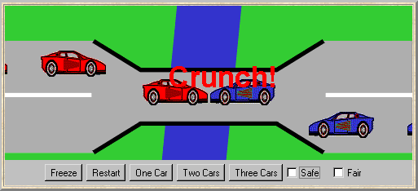
Single Lane Bridge
To ensure safety, the “safe” check box must be chosen in order to select the SafeBridge implementation.

Slide 25
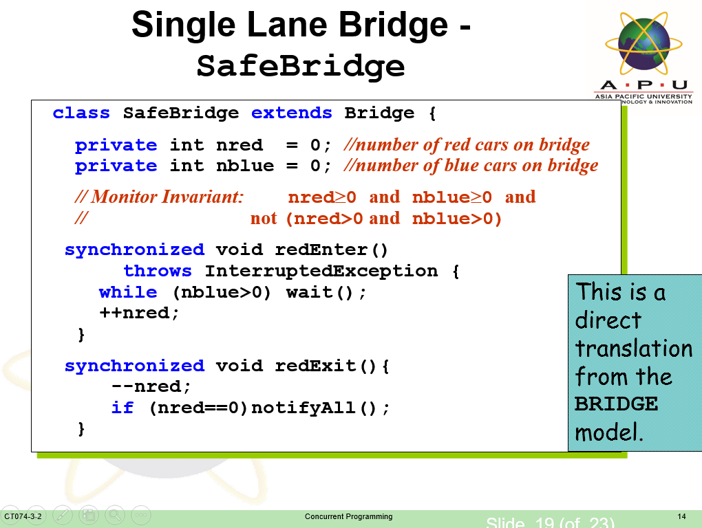

Slide 26
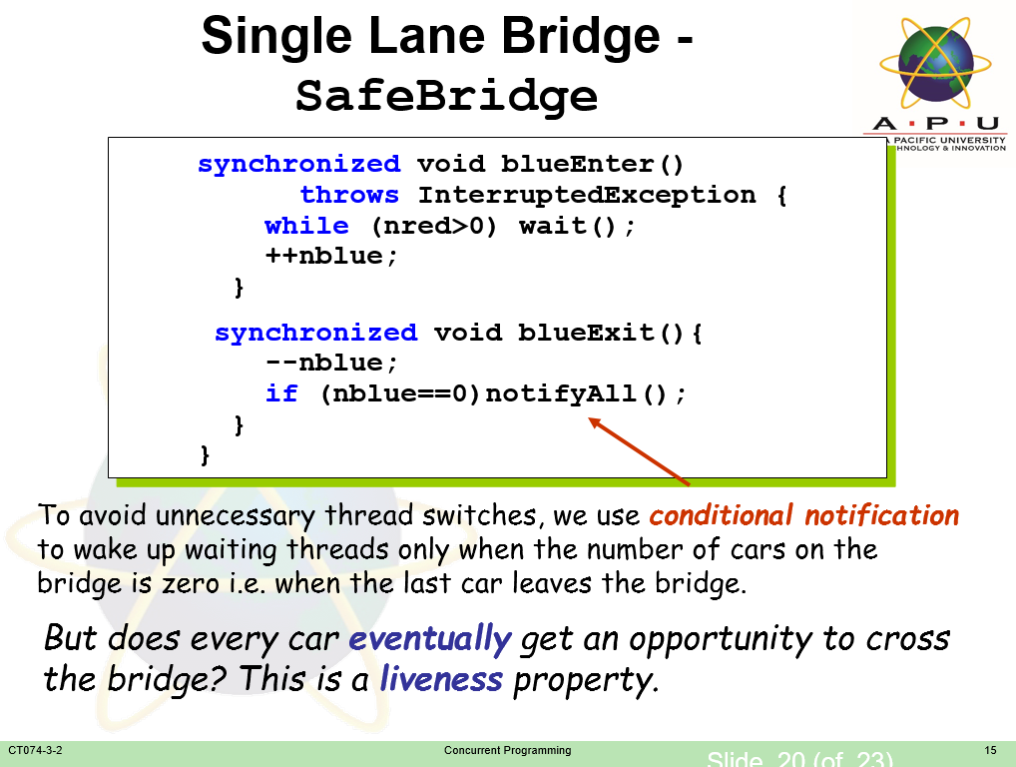

Slide 27

Resume at 3:50p.m.

Slide 28
Synchronized
One way to make Counter safe from thread interference is to make its methods synchronized, as in SynchronizedCounter:
class SynchronizedCounter {
private int c = 0;
public synchronized void increment() {
c++;
}
public synchronized void decrement() {
c--;
}
public synchronized int value() {
return c;
}
}

Slide 29
AtomicCounter:
import java.util.concurrent.atomic.AtomicInteger;
class AtomicCounter {
private AtomicInteger c = new AtomicInteger(0);
public void increment() {
c.incrementAndGet();
}
public void decrement() {
c.decrementAndGet();
}
public int value() {
return c.get();
}
}

Slide 30
java.util.concurrent
import java.util.concurrent.locks.Lock;
import java.util.concurrent.locks.ReentrantLock;
The Executor Interface
BlockingQueue
A first-in-first-out data structure that blocks or times out when you attempt to add to a full queue, or retrieve from an empty queue.
ConcurrentMap
a subinterface of java.util.Map that defines useful atomic operations.

Slide 31
References
Jeff M & Jeff K, Concurrency – State Models & Java Programming

Slide 32
Q & A

Slide 33
What we will cover next
Liveness

Slide 34
Safety and Liveness Properties
Concurrent Programming CT074-3-2 Version 0418

Slide 35
Topic & Structure of The Lesson
Liveness

Slide 36
Learning Outcomes
At the end of this module, you should be able to do the following:
Analyse concurrent systems for both safety and liveness.
Slide 2 (of 17)

Slide 37
Key Terms You Must Be Able To Use
If you have mastered this topic, you should be able to use the following terms correctly in your assignments and exams:
Liveness
Fairness

Slide 38
Synchronized
One way to make Counter safe from thread interference is to make its methods synchronized, as in SynchronizedCounter:
class SynchronizedCounter {
private int c = 0;
public synchronized void increment() {
c++;
}
public synchronized void decrement() {
c--;
}
public synchronized int value() {
return c;
}
}

Slide 39
AtomicCounter:
import java.util.concurrent.atomic.AtomicInteger;
class AtomicCounter {
private AtomicInteger c = new AtomicInteger(0);
public void increment() {
c.incrementAndGet();
}
public void decrement() {
c.decrementAndGet();
}
public int value() {
return c.get();
}
}

Slide 40
java.util.concurrent
import java.util.concurrent.locks.Lock;
import java.util.concurrent.locks.ReentrantLock;
The Executor Interface
BlockingQueue
A first-in-first-out data structure that blocks or times out when you attempt to add to a full queue, or retrieve from an empty queue.
ConcurrentMap
a subinterface of java.util.Map that defines useful atomic operations.

Slide 41
Safety & Liveness properties
Concepts: properties: true for every possible execution
safety: nothing bad happens
liveness: something good eventually happens
Practice: threads and monitors

Slide 42
Liveness
A safety property asserts that nothing bad happens.
A liveness property asserts that something good eventually happens.
Single Lane Bridge: Does every car eventually get an opportunity to cross the bridge?
ie. make PROGRESS?
A progress property asserts that it is always the case that an action is eventually executed. Progress is the opposite of starvation, the name given to a concurrent programming situation in which an action is never executed.

Slide 43
starvation-freedom implies deadlock-freedom, while deadlock-freedom does not imply starvation-freedom

Slide 44
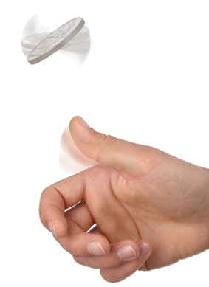
Progress properties - fair choice
Fair Choice: If a choice over a set of transitions is executed infinitely often, then every transition in the set will be executed infinitely often.
If a coin were tossed an infinite number of times, we would expect that heads would be chosen infinitely often and that tails would be chosen infinitely often.
This requires Fair Choice !

Slide 45
Progress - single lane bridge
The Single Lane Bridge implementation can permit progress violations.
Fair choice means that eventually every possible execution occurs, including those in which cars do not starve. To detect progress problems we must check under adverse conditions. We superimpose some scheduling policy for actions, which models the situation in which the bridge is congested.

Slide 46
Congested single lane bridge
Congestion using action priority?
Could give red cars priority over blue (or vice versa) ? In practice neither has priority over the other.
Instead we merely encourage congestion by lowering the priority of the exit actions of both cars from the bridge.
This corresponds with the observation that, with more than one car, it is possible that whichever colour car enters the bridge first will continuously occupy the bridge preventing the other colour from ever crossing.

Slide 47
Progress - analysis of revised single lane bridge model
The scenario in which there are cars waiting at both ends, and consequently, the bridge does not allow either red or blue cars to enter.
Introduce some asymmetry in the problem (cf. Dining philosophers).
This takes the form of a boolean variable (bt) which breaks the deadlock by indicating whether it is the turn of blue cars or red cars to enter the bridge.
Arbitrarily set bt to true initially giving blue initial precedence.

Slide 48
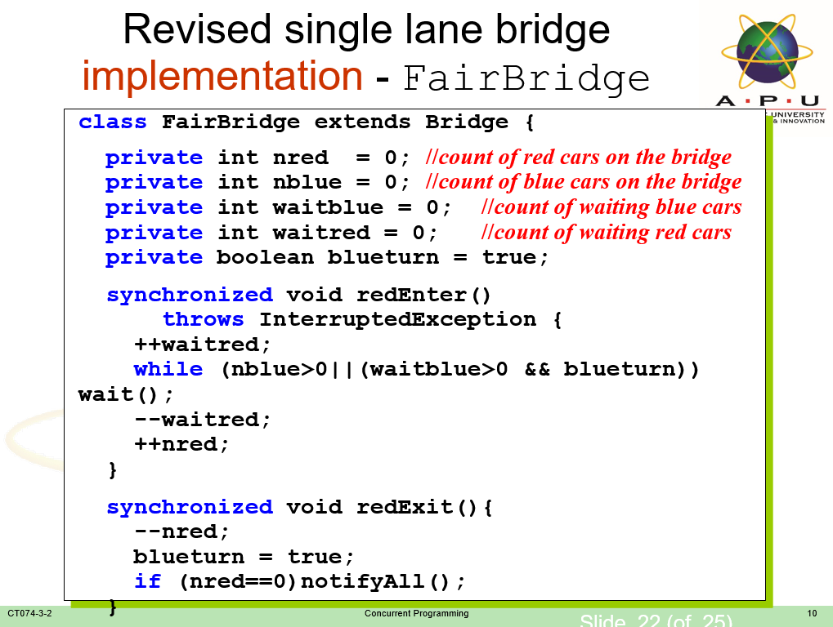

Slide 49
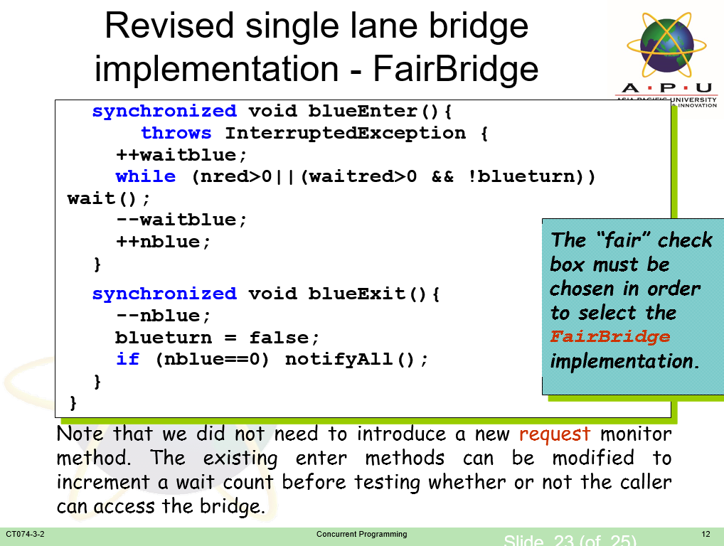

Slide 50
References
Jeff M & Jeff K, Concurrency – State Models & Java Programming

Slide 51
Q & A

Slide 52
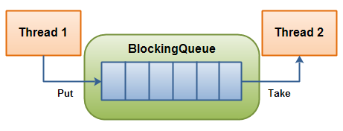
BlockingQueue
A BlockingQueue is typically used to have one thread produce objects, which another thread consumes.
This blockingqueue has 6 spaces.

Slide 53
What we will cover next
Parallel Programming

